Slide 1
Blackboard - collaborate ultra
A basic session for instructors

Slide 2
NOTE ADDITIONAL TRAINING AVAILABLE:
Workshops are available at: https://eapps.austincc.edu/workshops/www/login.php
Log in with your ACCeID and search for “Blackboard”
You will find these workshops
Blackboard 1: Building a Course Site – 2 hrs
Blackboard 2: Assignments and Assessments – 2 hrs
Blackboard 3: Grade Center – 2 hrs
Blackboard 4: Interactive Tools – 2hrs
Blackboard Collaborat Ultra Training – 1.5 hrs
Total of 9.5 hrs online and self-paced

Slide 3
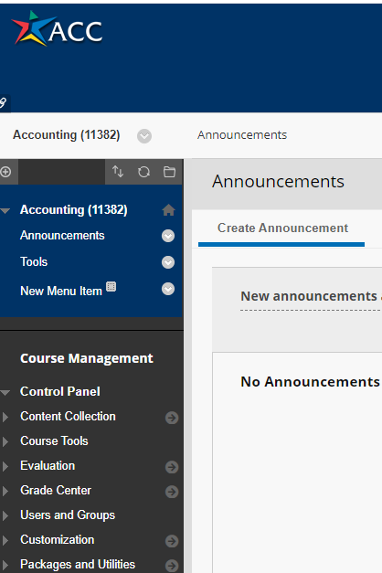
We begin with blackboard
COURSE MANAGEMENT TOOLS MENU
SELECT COURSE TOOLS

Slide 4
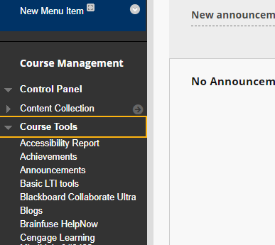
LOCATING COLLABORATE ON THE MENU

Slide 5
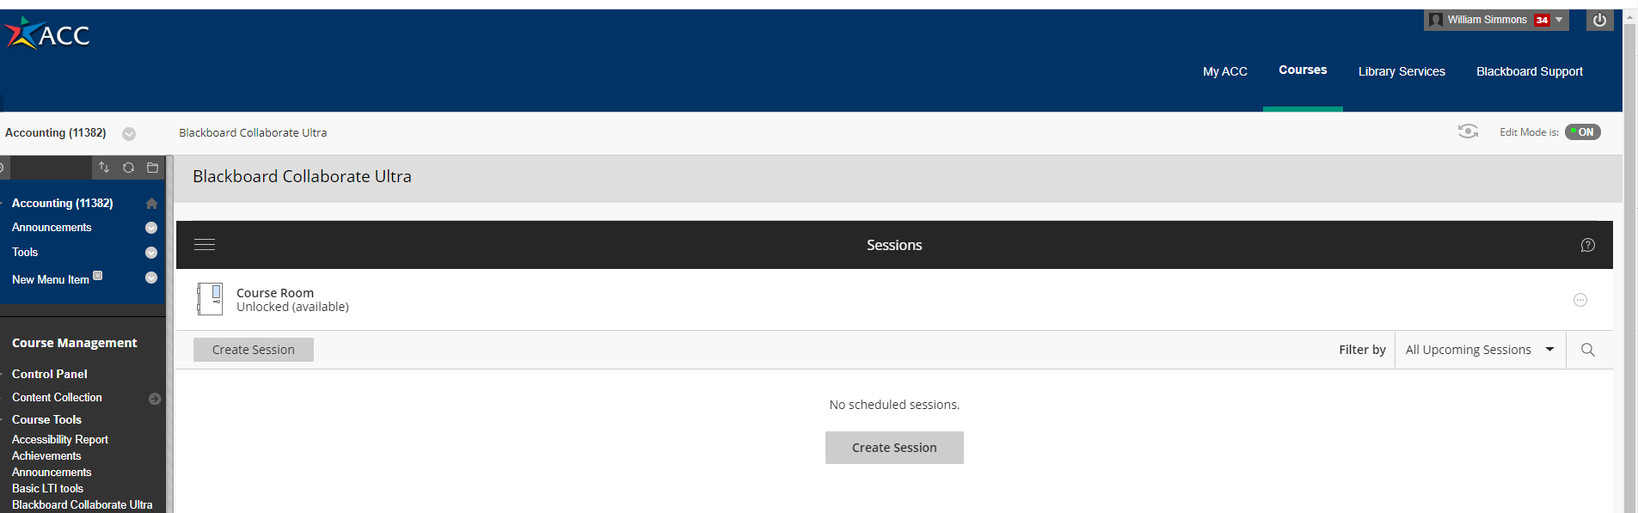
CREATE SESSION SCREEN
Select either entry button

Slide 6
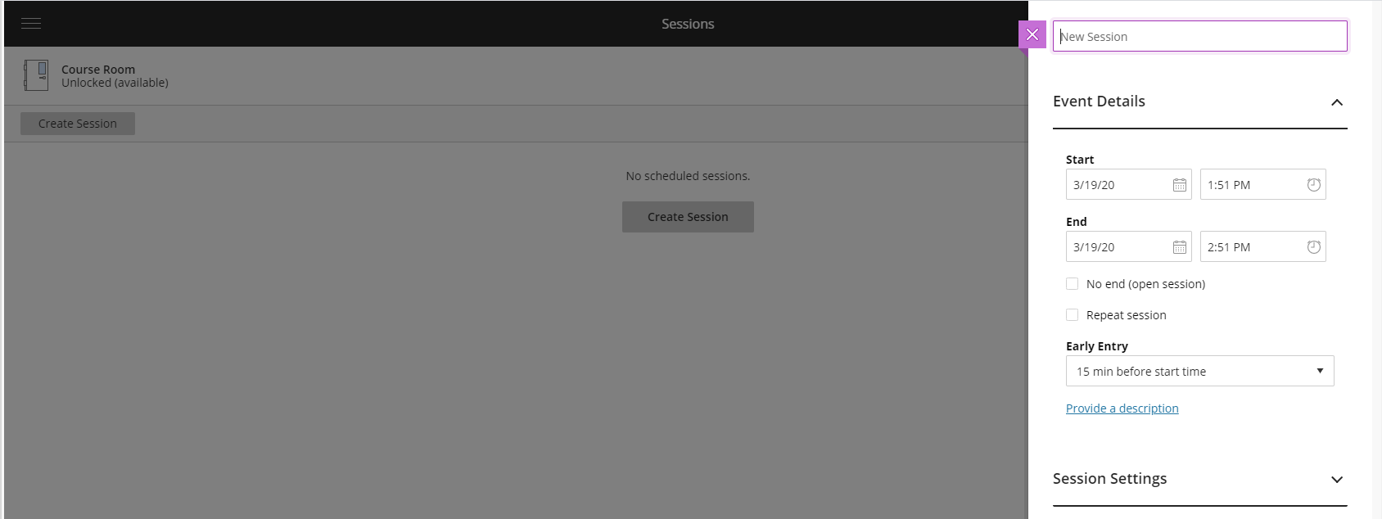
Setting up basic session information
FIRST ENTER A NAME FOR THE SESSION

Slide 7
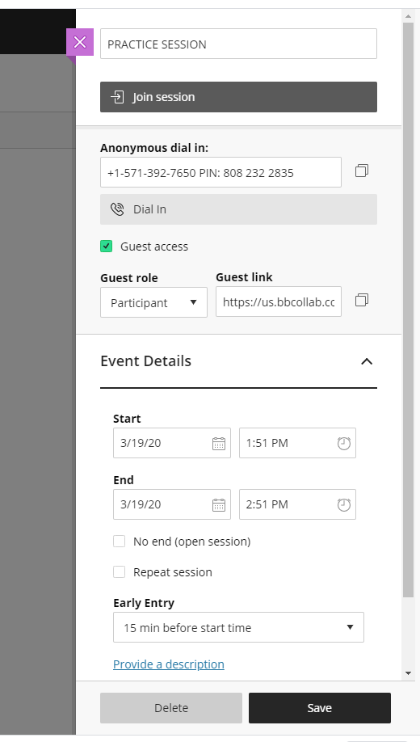
Event details
To join session once started
Phone # and PIN for session
Session Link
Guests role during session
Date/time for session
Time for you before session
Can enter a description
To save the settings

Slide 8
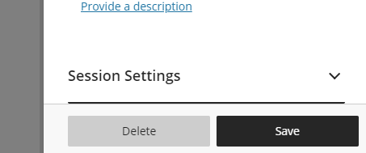
Explore session settings

Slide 9
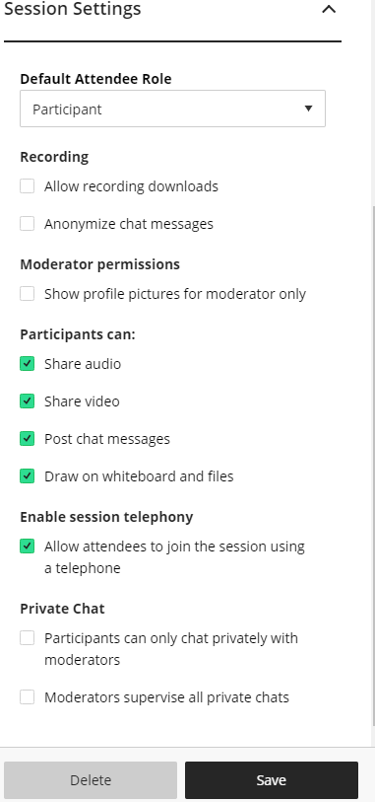
Session settings

Slide 10
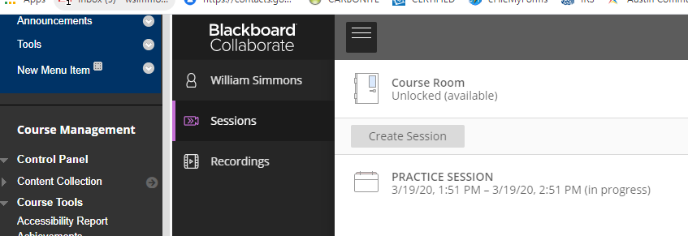
Course sessions/recordings
By clicking this menu, a sidebar opens showing other sessions that have been created and recording…..BUT ONLY FOR THE COURSE SELECTED

Slide 11
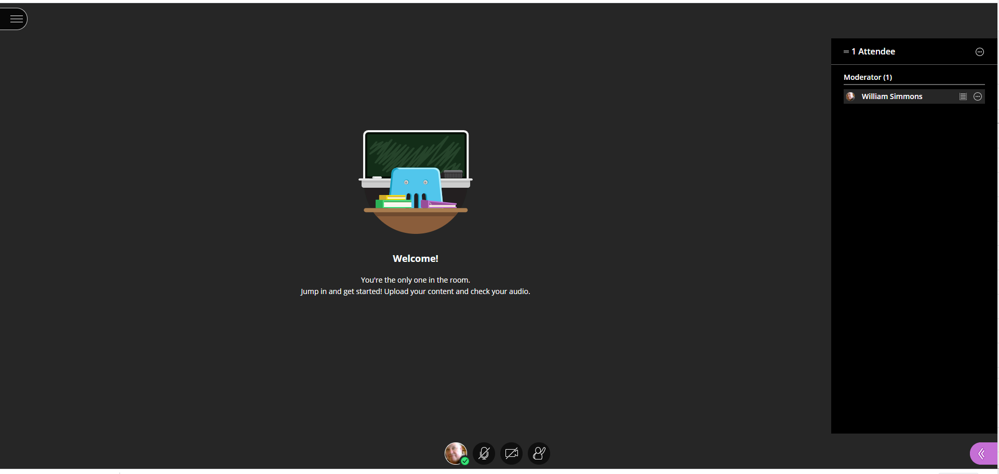
DURING SESSION
This is known as the “stage” and is where shared screens are shown
This opens moderator information
This purple button takes us to collaborate panel
These icons control mic, camera and one can raise their hand with questions

Slide 12
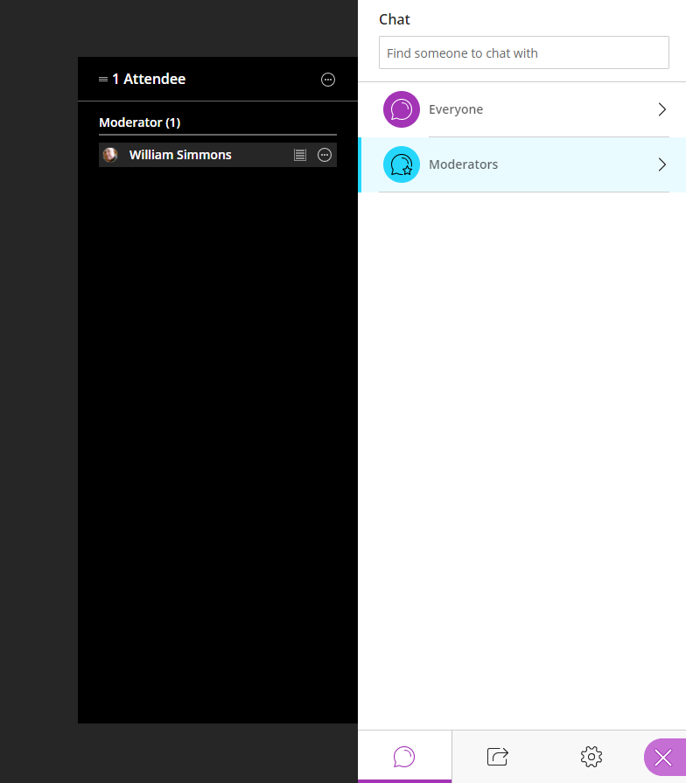
Moderator control panel
Chat selection icon

Slide 13
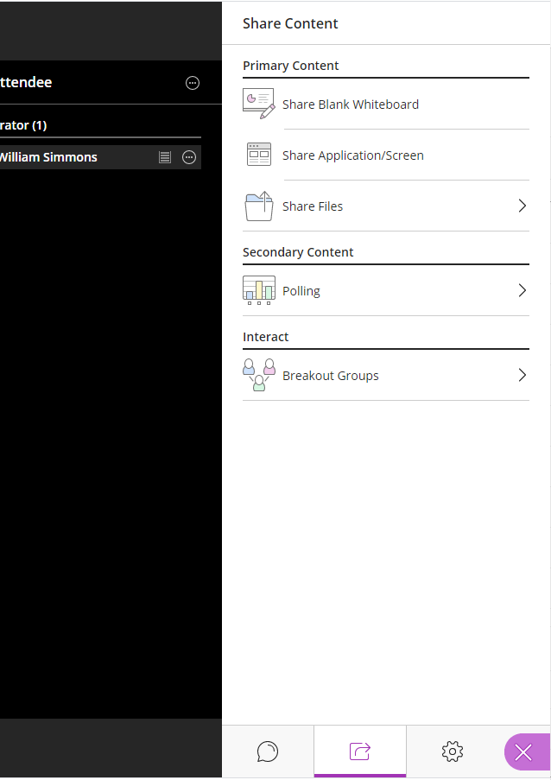
Share content controls

Slide 14
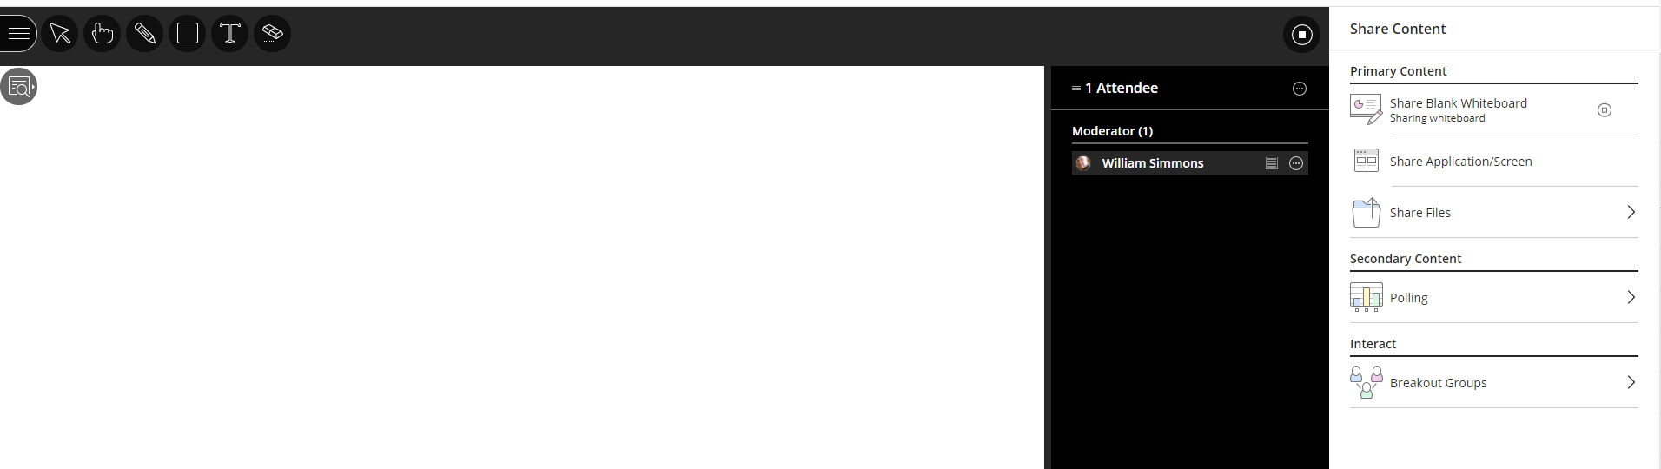
Share white board
White board controls

Slide 15
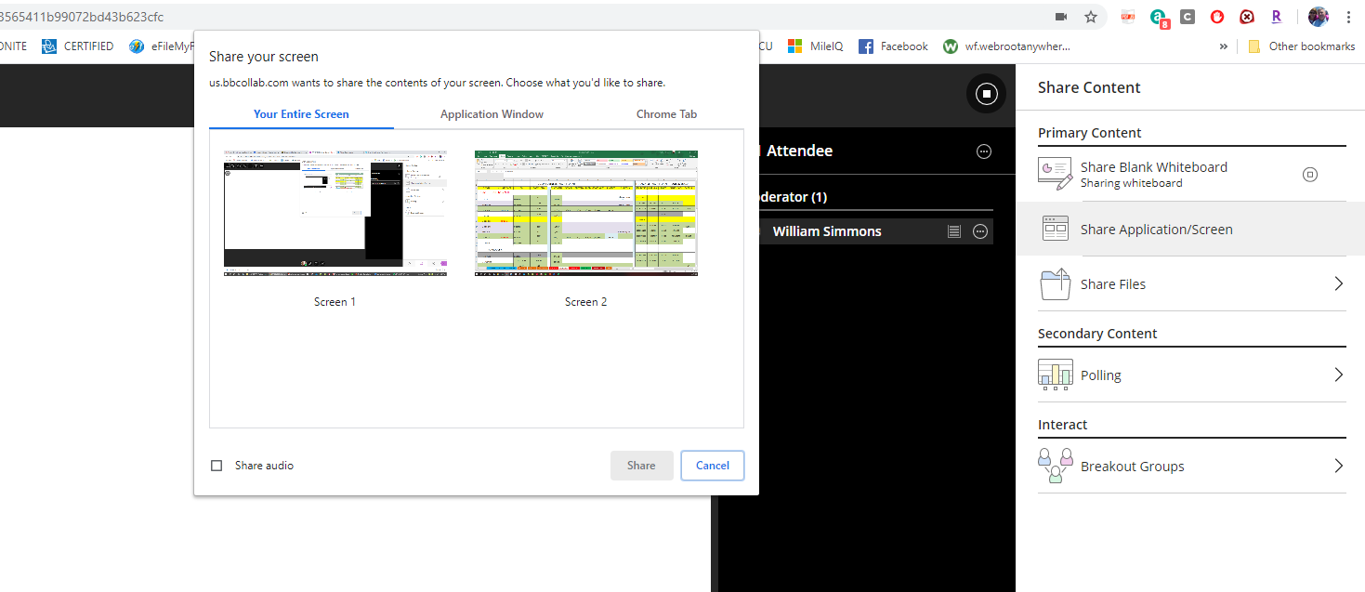
Sharing applications
If you have two screens, select the one you wish to share in the stage area

Slide 16
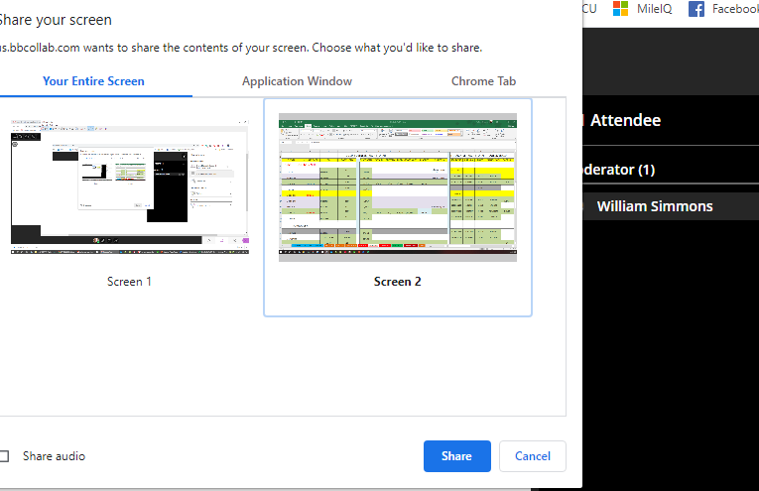
Selecting a screen to share

Slide 17
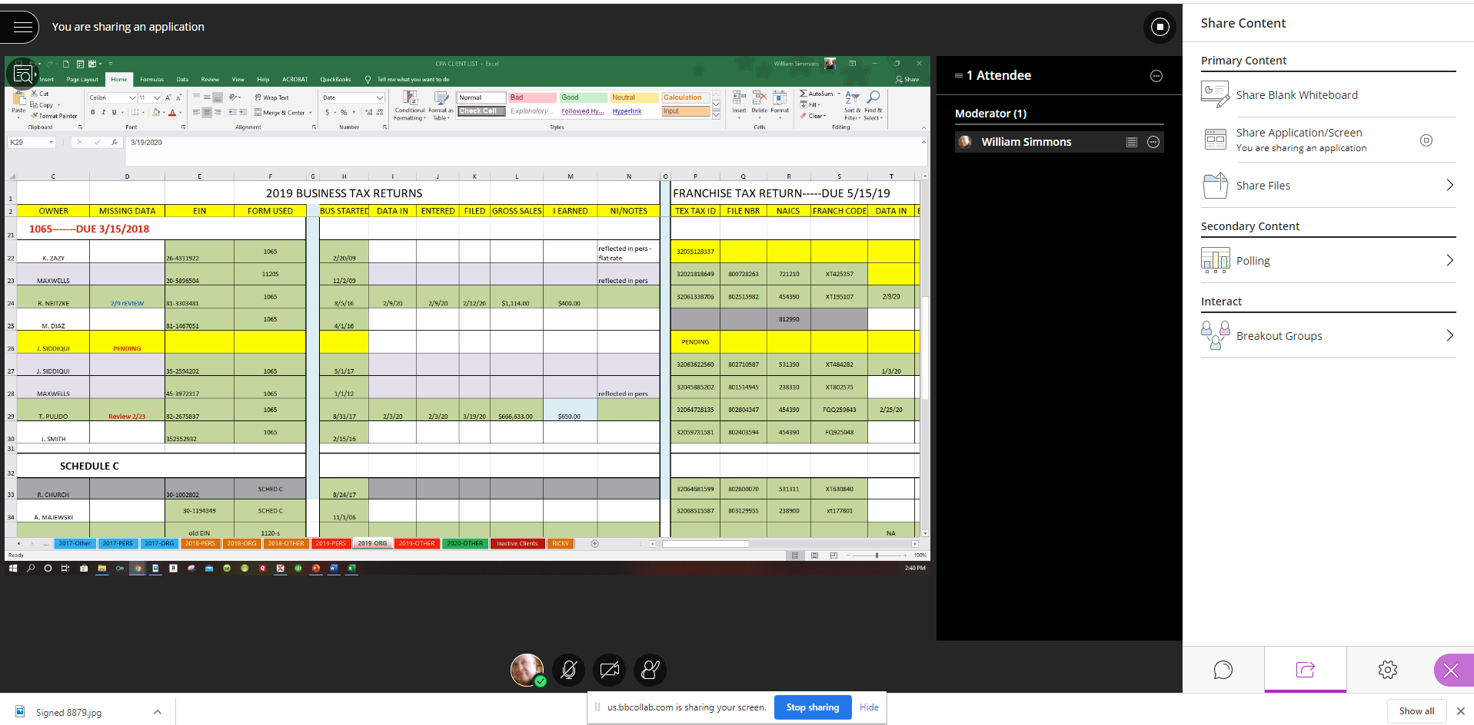
Sharing an applicaiton
To stop sharing

Slide 18
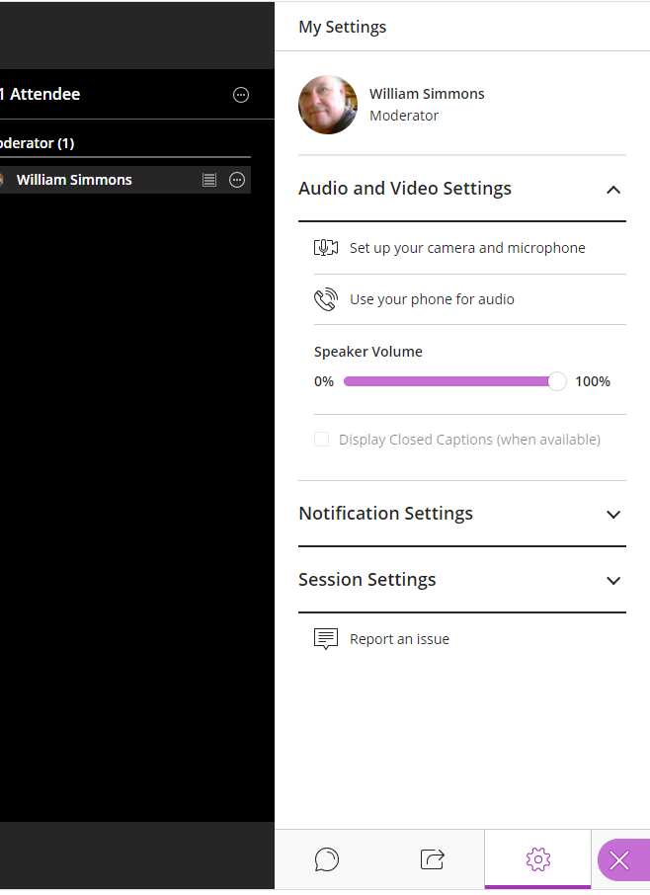
My setting control
Selection icon

Slide 19
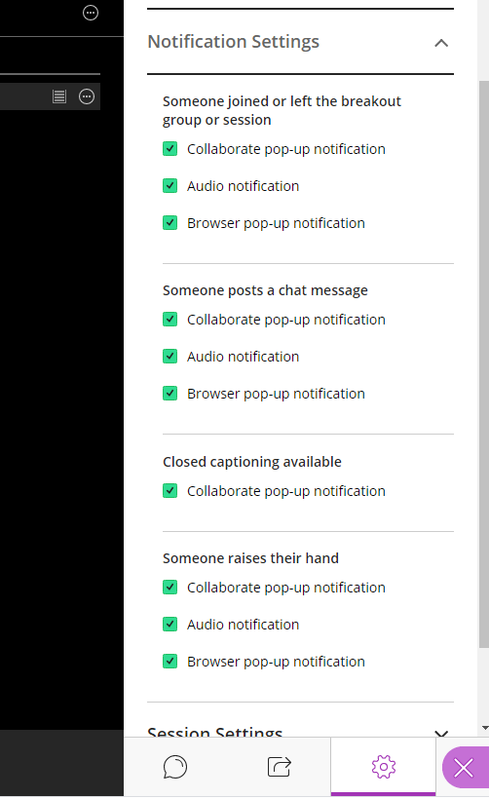
Notification settings

Slide 20
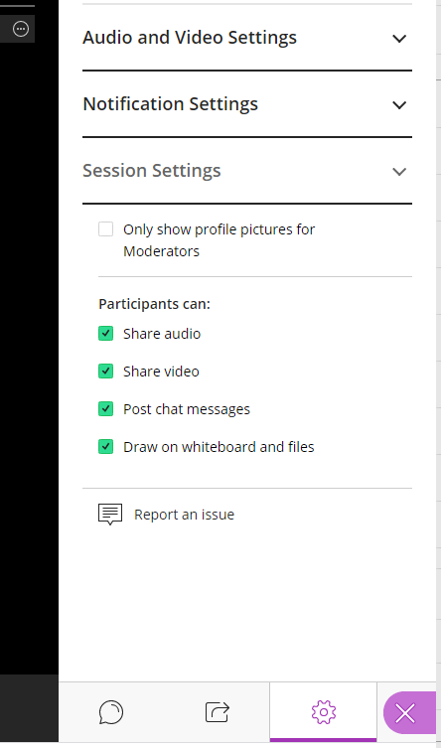
Session settings
To close the collaborate panel

Slide 21
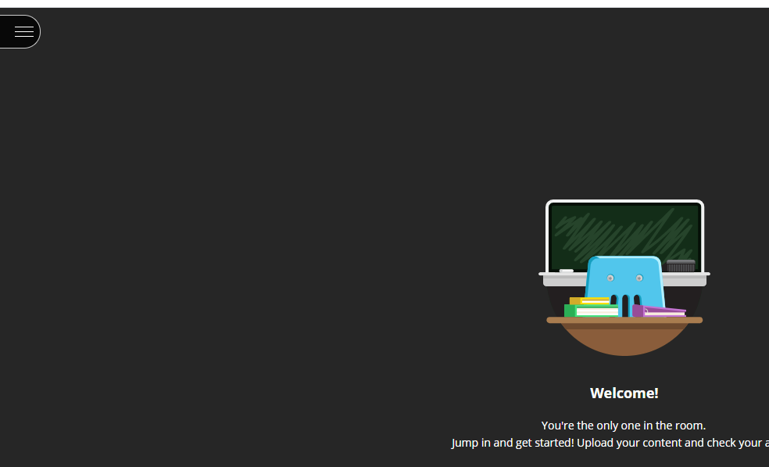
Open session menu
This is the open session menu icon

Slide 22
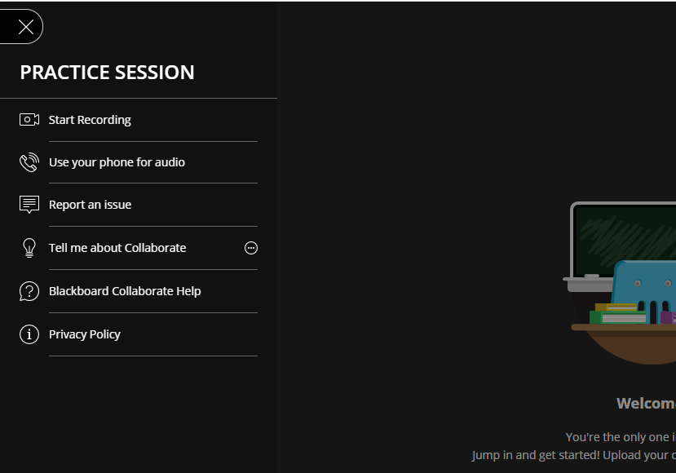
Contents of menu

Slide 23
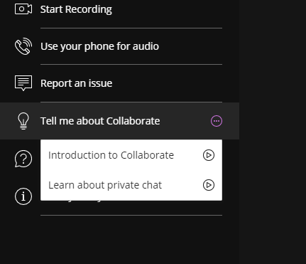
Tell me about collaborate option

Slide 24
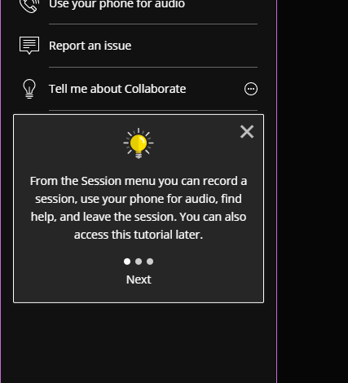
Information windows

Slide 25
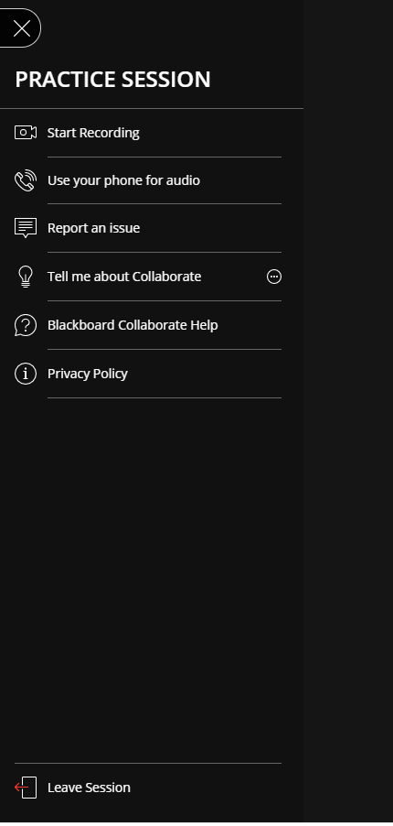
Leaving/returning to a session

Slide 26
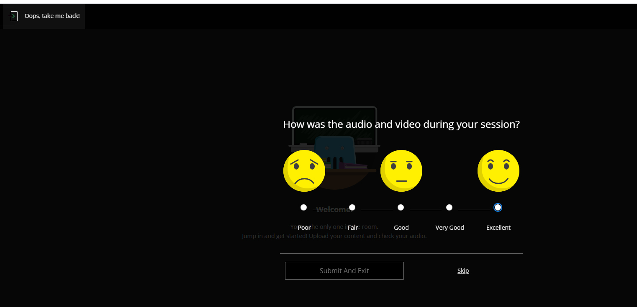
Oops take me back
Once session is over, rate performance of collaborate using the smiling faces
To return

